Slide 1
Artificial Intelligence
Lecture 2

Slide 2
Today’s Lecture
Informed (Heuristic) search
Heuristic evaluation function
Greedy Best-First Search
A* Search

Slide 3
Informed (Heuristic) Search
Informed heuristic search, also known as informed search or heuristic search, is a type of search algorithm used in artificial intelligence to efficiently explore a search space by using domain-specific knowledge or heuristics to guide the search towards the goal.
Unlike uninformed search algorithms, which explore the search space without any additional knowledge, informed heuristic search algorithms make use of information about the problem domain to make more informed decisions about which paths to explore.
The key idea behind informed heuristic search is to prioritize the exploration of paths that are more likely to lead to the goal, based on some heuristic evaluation of the state or node being considered.
This heuristic evaluation function estimates the cost or distance from the current state to the goal state, providing guidance to the search algorithm on which paths are more promising.

Slide 4
Heuristic evaluation function
A heuristic evaluation function, often simply referred to as a heuristic function or heuristic, is a function used in problem-solving and decision-making processes to estimate the potential for a given solution to lead to the goal or to evaluate the quality of a solution.
Heuristic evaluation function estimates the cost of an optimal path between a pair of states in a path-finding problem.
For example, airline distance is an estimate of the highway distance between a pair of locations.
For a fixed goal state, a heuristic evaluation is a function of a node, say h(n), that estimates the distance from node, say n to the goal state.
h(n)= estimated cost of the cheapest path from node n to a goal node.

Slide 5
Greedy Best-First Search
Greedy Best-First search tries to expand the node that is closest to the goal assuming it will lead to a solution quickly.
It refers specifically to a search with a heuristic that attempts to predict how close the end of a path is to a solution, so that paths which are judged to be closer to a solution are extended first.
  f(n) = h(n)
Implementation
  expand the “most desirable” node into the queue.
  sort the queue in decreasing order of desirability.
Example: consider the straight-line distance heuristic h_{SLD}
  Expand the node that appears to be closest to the goal

Slide 6
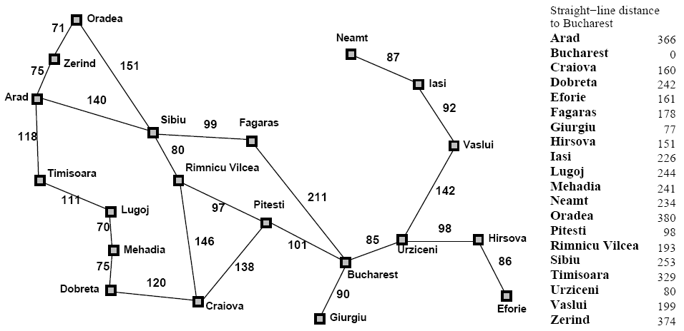
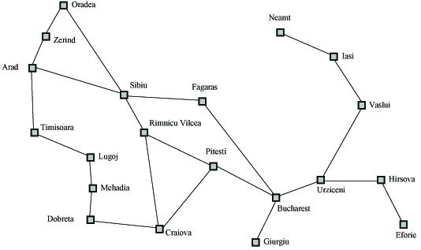
Greedy Best-First Search

Slide 7
Greedy Best-First Search
h_{SLD}(Arid) = 366
Notice that the values of h_{SLD} cannot be computed from the problem itself.
It takes some experience to know that h_{SLD} is correlated with actual road distances, therefore a useful heuristic.

Slide 8

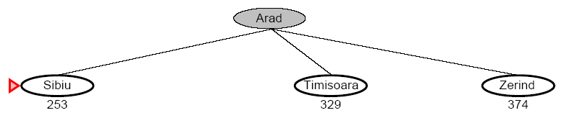
Greedy Best-First Search

Slide 9
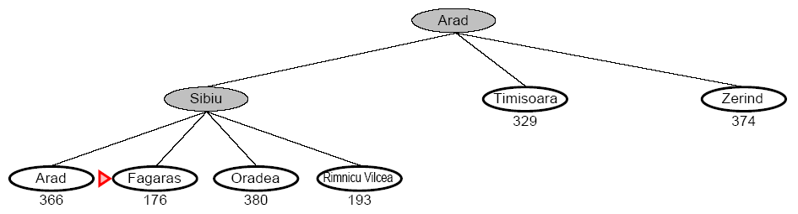
Greedy Best-First Search

Slide 10
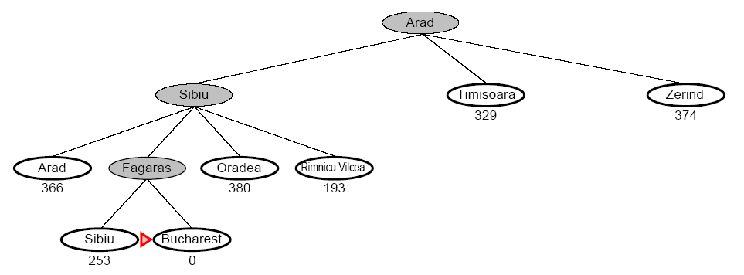
Greedy Best-First Search

Slide 11
A* Search
A* algorithm is a best-first search algorithm in which the cost associated with a node is
  f(n) = g(n)+ h(n)
where g(n)is the cost of the path from the initial state to node n and h(n)is the heuristic estimate or the cost of a path from node n to a goal.
Thus, f(n)estimates the lowest total cost of any solution path going through node n. At each point a node with lowest f value is chosen for expansion.
Ties among nodes of equal f value should be broken in favor of nodes with lower h values. The algorithm terminates when a goal is chosen for expansion.

Slide 12
A*
f(n) = g(n) + h(n)
  g(n) = “cost from the starting node to reach n”
  h(n) = “estimate of the cost of the cheapest path from n to the goal node”
h(n)
20
g(n)
15
n
10
5
15
18
20
25
33

Slide 13
A* Search

Slide 14

A* search example
Open List:
Arad
We start with our initial state Arad. We make a node and add it to the open list. Since it’s the only thing on the open list, we expand the node.
Think of the open list as a priority queue that sorts the nodes inside of it according to their f(n) = g(n)+h(n) score.

Slide 15
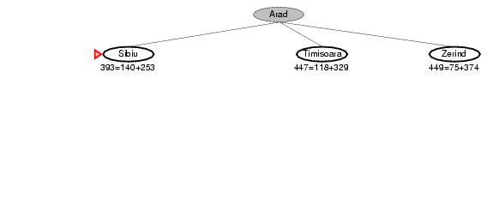
A* search example
Open List:
Sibiu
Timisoara
Zerind
We add the three nodes we found to the open list.
We sort them according to the f(n) = g(n)+h(n) calculation.

Slide 16
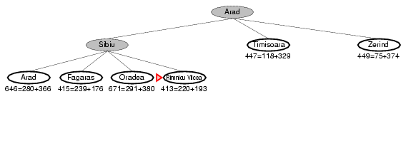
A* search example
Open List:
Rimricu Vicea
Fagaras
Timisoara
Zerind
Arad
Oradea
We’ve been to Arad before. Don’t list it again on the open list.
When we expand Sibiu, we run into Arad again. But we’ve already expanded this node once; so, we don’t add it to the open list again.

Slide 17
A* search example
Open List:
Rimricu Vicea
Fagaras
Timisoara
Zerind
Oradea
We see that Rimricu Vicea is at the top of the open list; so, it’s the next node we will expand.

Slide 18
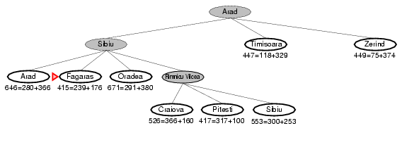
A* search example
Open List:
Fagaras
Pitesti
Timisoara
Zerind
Craiova
Sibiu
Oradea
When we expand Rimricu Vicea, we run into Sibiu again.
But we’ve already expanded this node once; so, we don’t add it to the open list again.

Slide 19
A* search example
Open List:
Fagaras
Pitesti
Timisoara
Zerind
Craiova
Oradea
Fagaras will be the next node we should expand – it’s at the top of the sorted open list.

Slide 20
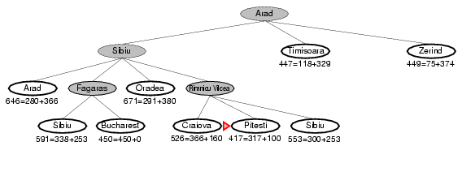
A* search example
Open List:
Pitesti
Timisoara
Zerind
Bucharest
Craiova
Sibiu
Oradea
When we expand Fagaras, we find Sibiu again. We don’t add it to the open list.
We also find Bucharest, but we’re not done. The algorithm doesn’t end until we “expand” the goal node – it has to be at the top of the open list.

Slide 21
A* search example
Open List:
Pitesti
Timisoara
Zerind
Bucharest
Craiova
Oradea
It looks like Pitesti is the next node we should expand.

Slide 22
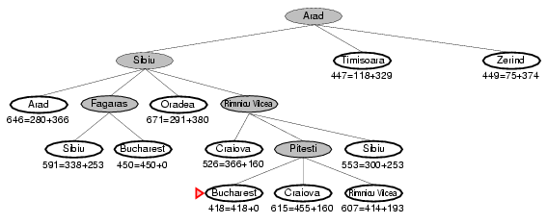
A* search example
Open List:
Bucharest
Timisoara
Zerind
Craiova
Rimricu Vicea
Oradea
We just found a better value for Bucharest; so, it got moved higher in the list. We also found a worse value for Craiova – we just ignore this.
And of course, we ran into Rimnicu Vicea again. Since it’s already been expanded once, we don’t re-add it to the Open List.

Slide 23
A* search example
Open List:
Bucharest
Timisoara
Zerind
Craiova
Oradea
Now it looks like Bucharest is at the top of the open list…

Slide 24
A* search example
Open List:
Bucharest
Timisoara
Zerind
Craiova
Oradea
Now we “expand” the node for Bucharest.
We’re done! (And we know the path that we’ve found is optimal.)

Slide 25

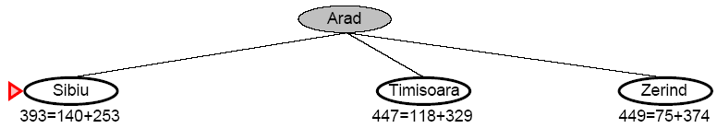
A* Search

Slide 26
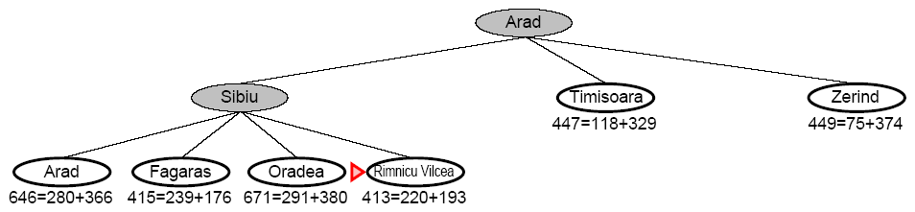
A* Search

Slide 27
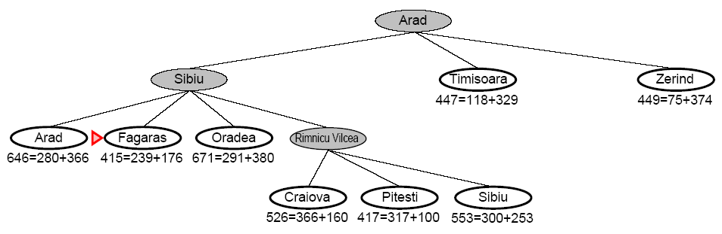
A* Search

Slide 28
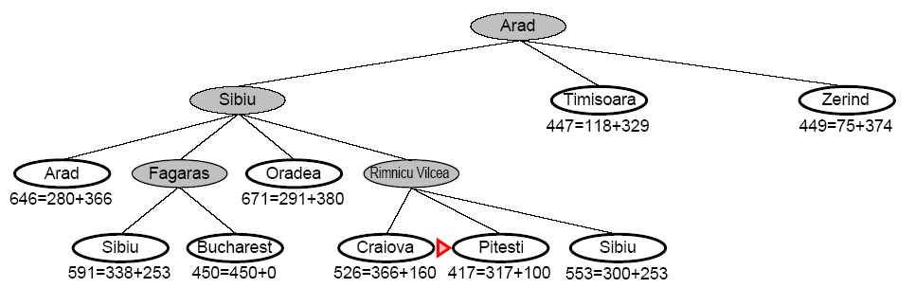
A* Search

Slide 29
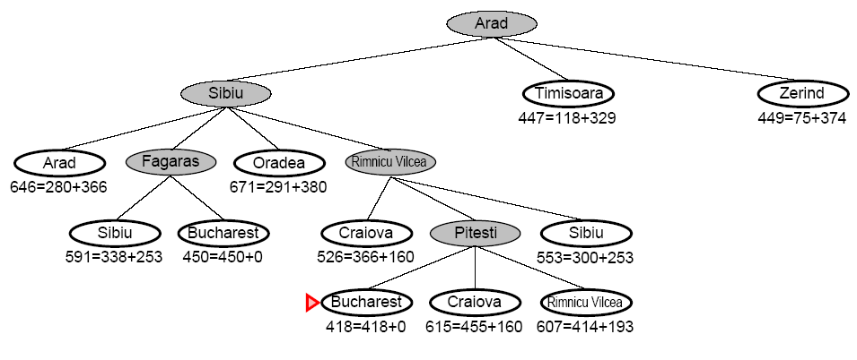
A* Search

Slide 30
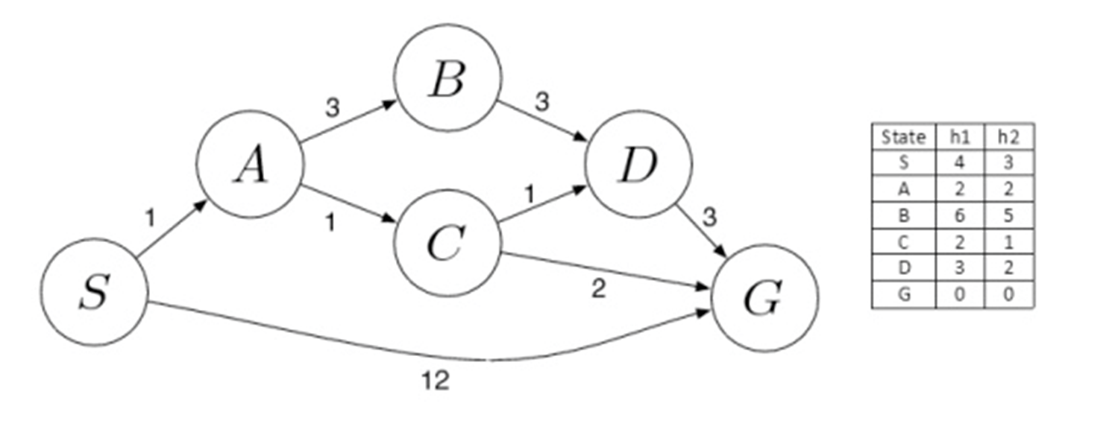
Exercise

Slide 31
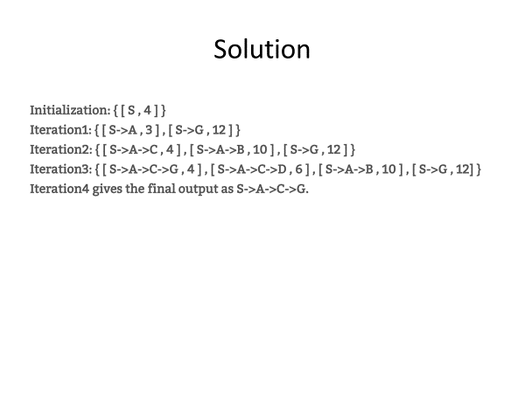

Slide 32
Summary of Today’s Lecture
Informed (Heuristic) search
Heuristic evaluation function
Greedy Best-First Search
A* Search

